Slide 1
Object Oriented Analysis & Design Module-5 (RL 5.3.4)
Harvinder S Jabbal

Slide 2
Guidelines for Package Diagram

Slide 3
Guidelines for Package Diagrams
Class Package Diagrams
Use Case Package Diagrams
Packages

Slide 4
Class Package Diagrams
Create UML Component Diagrams to Physically Organize Your Design.
Place Subpackages Below Parent Packages.
Vertically Layer Class Package Diagrams.
Create Class Package Diagrams to Logically Organize Your Design.

Slide 5
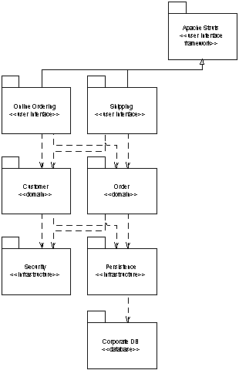
Package Diagram
UML Class diagram organized into packages.

Slide 6
Guideline
Use the package guidelines heuristics given below to organize UML Class diagrams into package diagrams:
Place the classes of a framework in the same package.
Classes in the same inheritance hierarchy typically belong in the same package.
Classes related to one another via aggregation or composition often belong in the same package.
Classes that collaborate with each other a lot, information that is reflected by your UML Sequence diagrams and UML Collaboration diagrams, often belong in the same package.

Slide 7
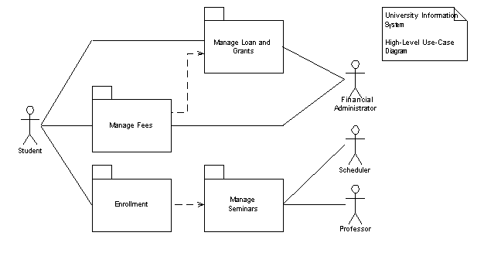
Use Case Package Diagrams
Create Use Case Package Diagrams to Organize Your Requirements
Include Actors on Use Case Package Diagrams
Horizontally Arrange Use Case Package Diagrams

Slide 8
Packages
Guideline applicable to the application of packages on any UML diagram, not just package diagrams. -
Give Packages Simple, Descriptive Names
Apply Packages to Simplify Diagrams
Packages Should be Cohesive
Indicate Architectural Layers With Stereotypes on Packages
Avoid Cyclic Dependencies Between PackagesPackage
Dependencies Should Reflect Internal Relationships

Slide 9
Acknowledgement
Slides are based on Course Text Books:
Applying UMP and Patterns (An Introduction to Object-Oriented Analysis and Design and Iterative Development) : Craig Larman
UMP Distilled (A Brief Guide to the Standard Object Modeling Langauge) : Martin Fowler
Design Patterns (Elements of Reusable Object-Oriented Software) : Erich Gama | Richard Helm | Rapph Johnson | John Vlissides alias GoF.
Also: http://agilemodeling.com/style/packageDiagram.htm
http://www.uml-diagrams.org/package-diagrams.htm

